Slide 1
Univariate Data
Examples

Slide 2
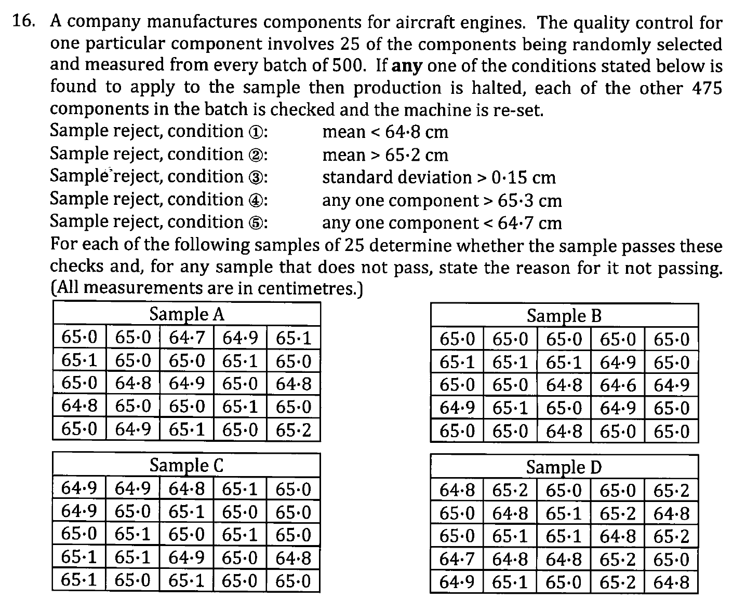

Slide 3
